Slide 1

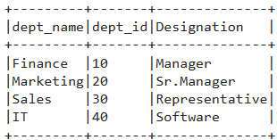
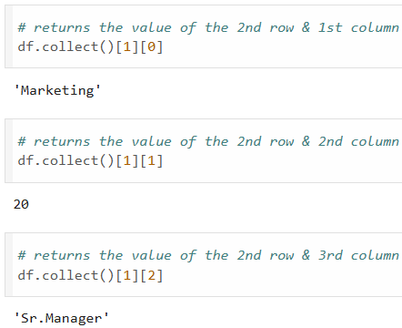
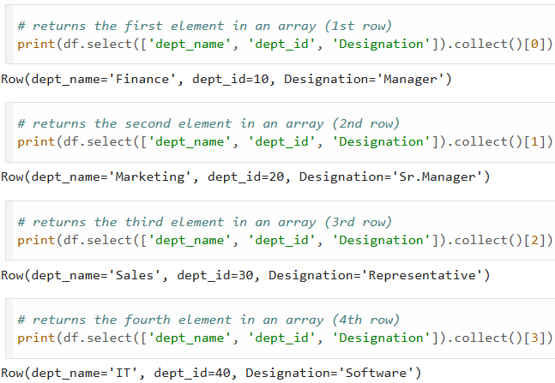

collect()
collect() function in PySpark?
- How to Retrieve data from DataFrame?
- How to retrieve all the elements of the dataset (from all nodes) to the driver node?

